Slide 1

2026.07.29
강화학습으로 스피드런 세계 기록 달성하기
Achieving World Record on Speed Run Using RL
팀 명: CV 2팀

Slide 2
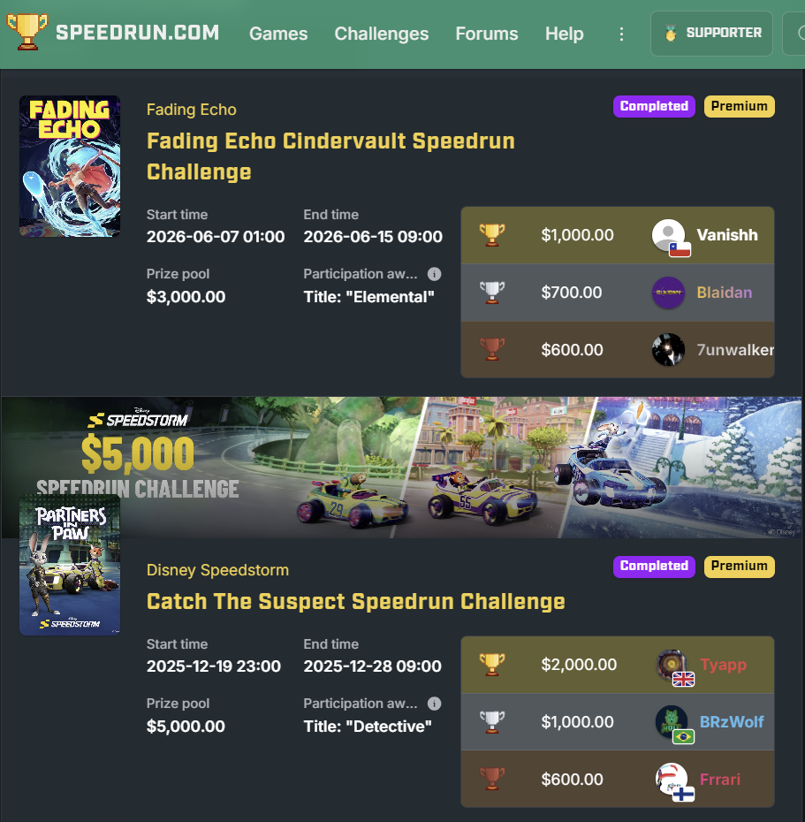
What is Speed Run?

Slide 3
QWOP

Slide 4
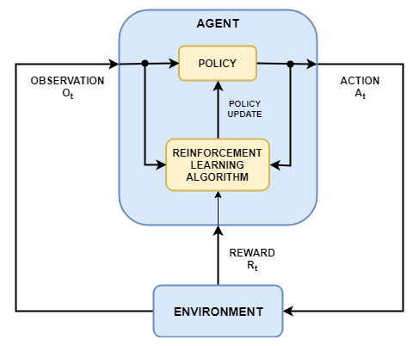
Reinforcement Learning
Agent
Environment
State
Action
Reward

Slide 5

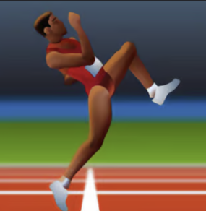

Environment
Computer Vision
VS.
How far?
Number of Frame(how fast)
Feet on the ground
Body Center gravitation

Slide 6

Action
16 Combinations
- 1 integer variable[0, 15]
- 4 different Boolean variable
→ Continuous Action

Slide 7
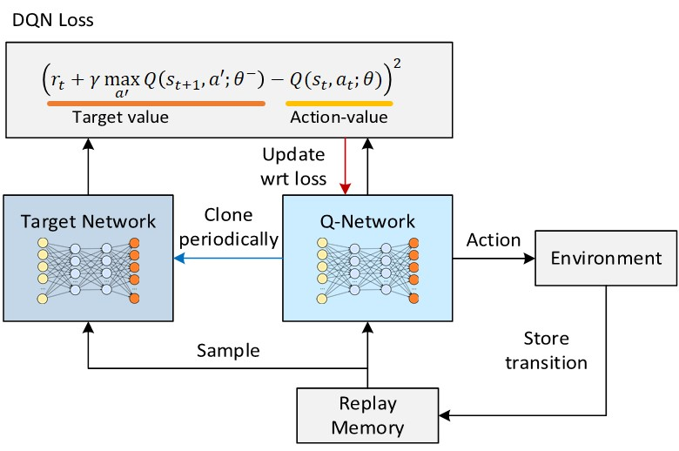
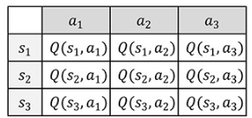
Algorithm 1. Deep Q-Network
Too much memory usage
For continuous action

Slide 8
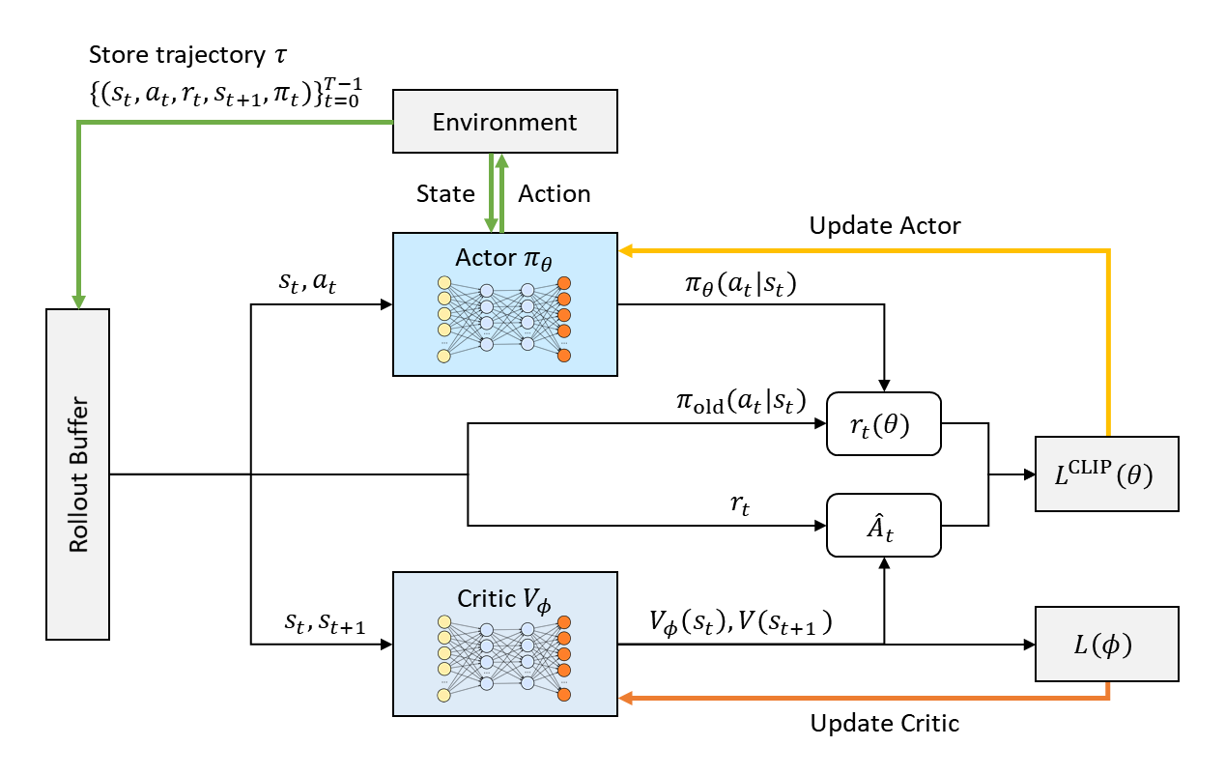

Algorithm 2. Proximal Policy Optimization(PPO)
→ Lowers the degree of update
On-Policy: 1experiment, 1 optimization
→ Lower memory usage
- 1 integer variable[0, 15]

Slide 9
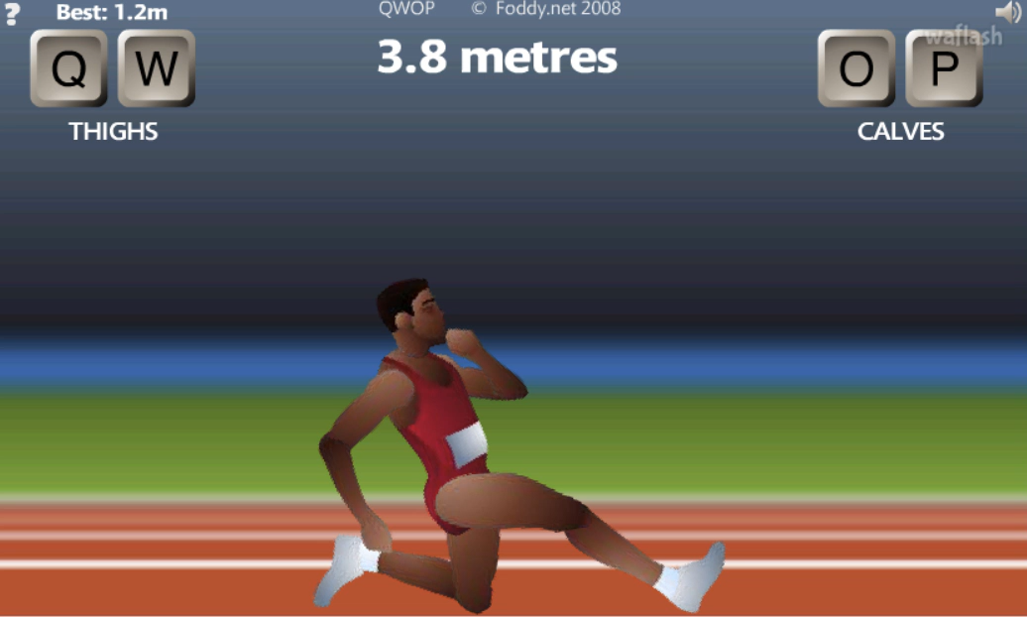



Challenge 1. Regulation Setting
1. Set Reward Function
2. Hyperparameter Tuning
→ Trap in local minima

Slide 10
Challenge 1. Regulation Setting
Task: To approximate optimal function
→ Applying Heuristic based on its goal
Our goal is to get a ‘World Record’
Which we don’t know how
Impossible to establish feasibility of any instructions

Slide 11
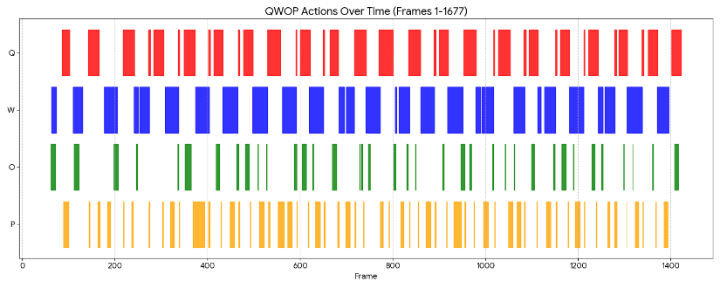
Challenge 2. Ensuring Continuity
> Key log of World Record
> Short period of pressing keys
1. Set Reward Function
2. Chage Action
4 integer variable → how long to press each button
(Now we are solving discrete problem)

Slide 12
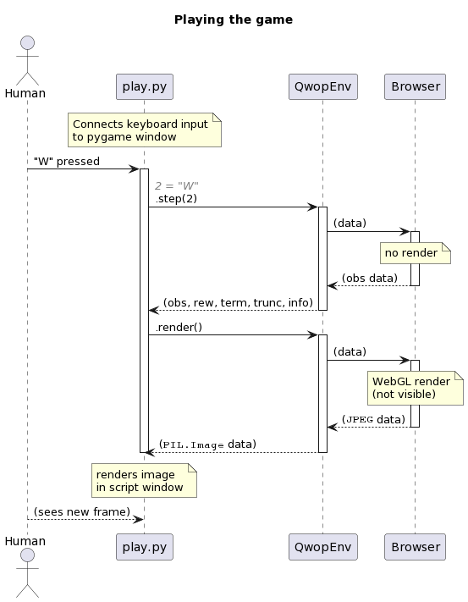
Training

Slide 13
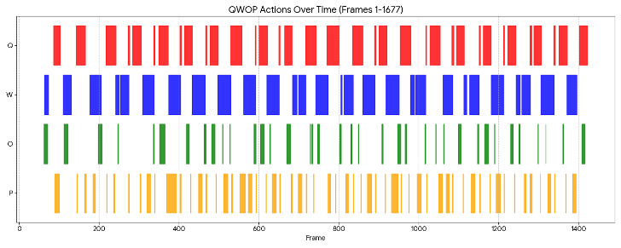
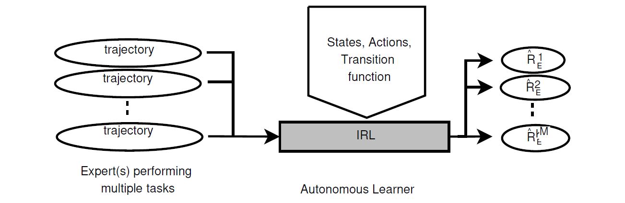
Inverse Reinforcement Learning
> Key log of World Record
> Structure
Strongly fit to World Record
Tasks
Setting video, game frame identical
Solve Distribution Shift problem(Not good for new env)

Slide 15
Still working on it..!

